Slide 1
Problem youth
Problem youth - one of the main, because, no matter how corny it sounds, for her future. But "the present age" and "the last age" is always in conflict. And always will be. But why do we think that the older generation is not always right, seeking the origins of the problems when they are on the surface or not there looking for them? Probably because today's youth are not so highly developed sense of responsibility, or it is not strongly ingrained in young minds. When you fourteen years, it seems that the life to come, and if they make some mistakes ahead is so long to fix it. Our young people do not care about those needs, which stimulate various youth movements in the West, and the problem of overcoming the difficulties of life, sometimes just physical survival.
The most coveted prospect for today's teenagers is rapid achievement of the prestigious social status.

Slide 2
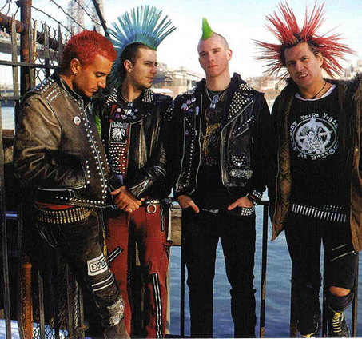
Informals
Informals are very different from each other stated goals, values, and, as a result, behavior and pastime. For example, combined on the basis of preference for certain styles of music and dance.

Slide 3

Skinheads
Skinheads - their distinctive symbol - the swastika, a sign that does not even speak, and screams for itself.
Teens - skinheads stand out from the crowd shaved heads and black clothes, pants tucked into boots. Sometimes the clothing present image pit bull. In public places, trying to appear little groups. They can be found mostly in the evening, when it's "their" time

Slide 4
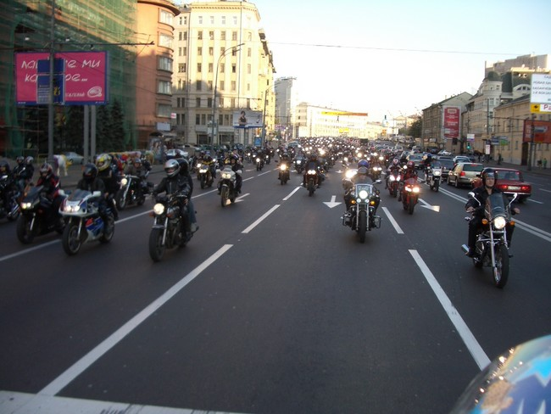
Bikers
Bikers-goers and fans of motorcycles. Unlike normal motorcycle, the biker motorcycle is part of the lifestyle. Also characteristic is the association with peers based on this way of life.

Slide 5
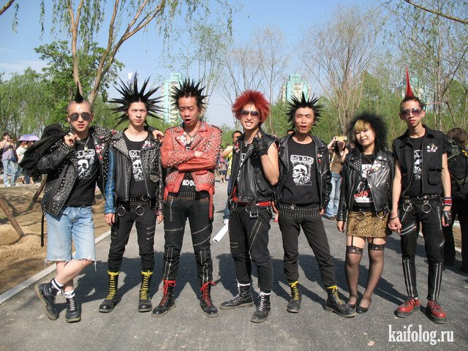
Punks
Punk culture different to their own style of music, ideology and fashion. It is reflected in the visual arts, dance, literature and film. Supporters of this movement are against commercialization, which is one of the basic mechanisms of capitalism.

Slide 6
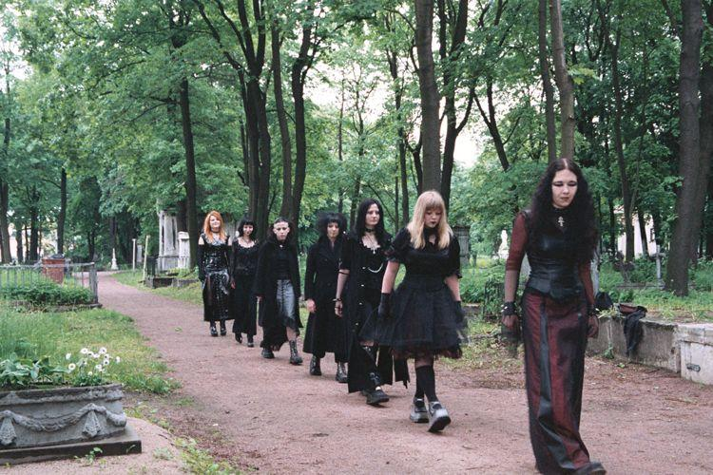
Goths
Goths. Subculture prepared a modern trend, which is common to many countries. Its imaging system and cultural preferences have clearly demonstrated with the ideals of gothic literature, dating from the nineteenth century.

Slide 7

Emo
Emo representatives are well known for their style and ideology, which is quite clearly stated in the relevant music. Basic concepts of emo: sadness, longing and love are expressed in musical performance by means of specific techniques, such as screaming, leading the audience in the proper mood. In the broader sense of being emo means to be in sorrow and write poetry

Slide 8
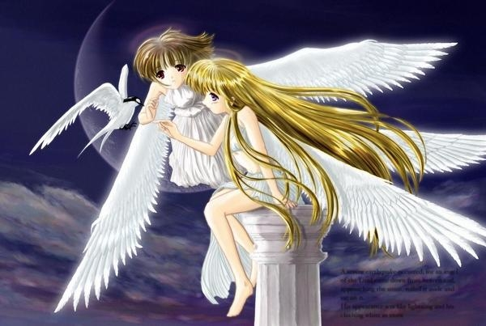
Anime
Anime - this is primarily the name of animated pictures that are made in Japan. Widest segment were adolescents aged 12-15 years, that is, in an age when the mind is most susceptible to external images, and imagination helps to recreate the necessary pictures. And there was a subculture of anime in some ways similar to that of their families who are almost Tolkien. Namely, the fact that they are trying to recreate in real life what they saw on the screen.

Slide 9
Conclusions
Subcultural phenomena are easy to describe, but their classification and typology difficult irreducible variety in symptoms.
Some of the youth subcultures can create a platform for the development of negative tendencies in youth, others likely have a positive social value.
Youth subcultures bear the impact of the criminalization of society, the Western cultural expansion thrust to overcome the routine of everyday life.

